Slide 1
Operator overloading
ThanhNT

Slide 2
Introduction
int x = 2;
int y = 3;
x+y = ?
Mystring string1 = "Hello, ";
Mystring string2 = "World!“
string1+string2 = ?
In C++, operators are implemented as functions. By using function overloading on the operator functions, you can define your own versions of the operators that work with different data types (including classes that you’ve written).
Using function overloading to overload operators is called operator overloading.

Slide 3
Limitations
Almost any existing operator in C++ can be overloaded. The exceptions are: conditional (?:), sizeof, scope (::), member selector (.), and member pointer selector (.*).
You can only overload the operators that exist. You can not create new operators or rename existing operators. For example, you could not create an operator ** to do exponents.
At least one of the operands in an overloaded operator must be a user-defined type. This means you can not overload the plus operator to work with one integer and one double
It is not possible to change the number of operands an operator supports
All operators keep their default precedence and associativity

Slide 4
Overloading the arithmetic operators +,-,*,/ (1/3)
class MinMax
{
private:
int m_min; // The min value seen so far
int m_max; // The max value seen so far
public:
MinMax(int min, int max)
{
m_min = min;
m_max = max;
}
int getMin() { return m_min; }
int getMax() { return m_max; }
friend MinMax operator+(const MinMax &m1, const MinMax &m2);
friend MinMax operator+(const MinMax &m, int value);
friend MinMax operator+(int value, const MinMax &m);
};

Slide 5
Overloading the arithmetic operators +,-,*,/ (2/3)
MinMax operator+(const MinMax &m1, const MinMax &m2)
{
// Get the minimum value seen in m1 and m2
int min = m1.m_min < m2.m_min ? m1.m_min : m2.m_min;
// Get the maximum value seen in m1 and m2
int max = m1.m_max > m2.m_max ? m1.m_max : m2.m_max;
return MinMax(min, max);
}
MinMax operator+(const MinMax &m, int value)
{
// Get the minimum value seen in m and value
int min = m.m_min < value ? m.m_min : value;
// Get the maximum value seen in m and value
int max = m.m_max > value ? m.m_max : value;
return MinMax(min, max);
}
MinMax operator+(int value, const MinMax &m)
{
// call operator+(MinMax, nValue)
return (m + value);
}

Slide 6
Overloading the arithmetic operators +,-,*,/ (3/3)
int main()
{
MinMax m1(10, 15);
MinMax m2(8, 11);
MinMax m3(3, 12);
MinMax mFinal = m1 + m2 + 5 + 8 + m3 + 16;
std::cout << "Result: (" << mFinal.getMin() << ", " << mFinal.getMax() << ")\n";
return 0;
}
Result

Slide 7
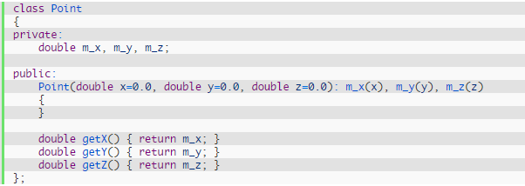


Overloading the I/O operators <<
How to print the position of a point???

Slide 8
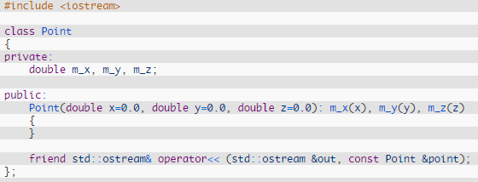
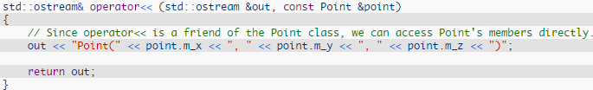
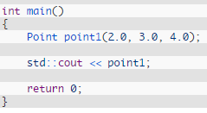
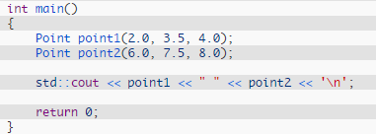
Overloading the I/O operators <<
Point(2, 3.0, 4)
Point(2, 3.5, 4) Point(6, 7.5, 8)

Slide 9
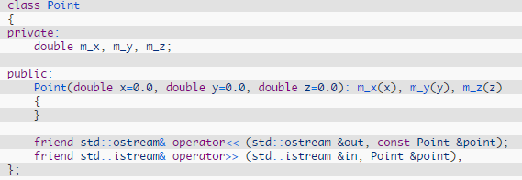
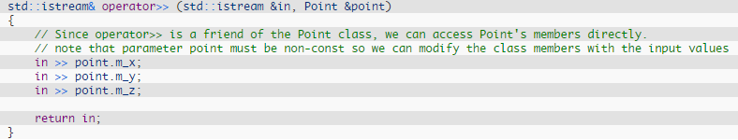
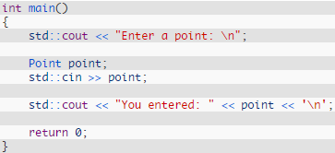
Overloading the I/O operators >>

Slide 10
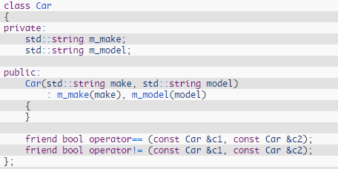


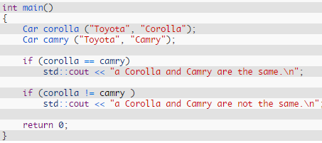
Overloading the comparison operators ==, !=, >, <….

Slide 11
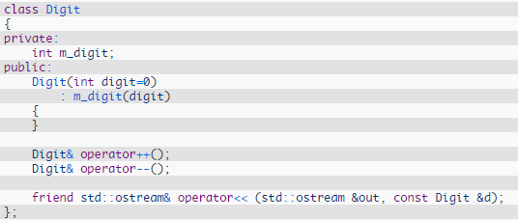
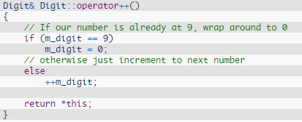
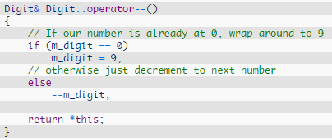
Overloading the increment and decrement operators - prefix

Slide 12
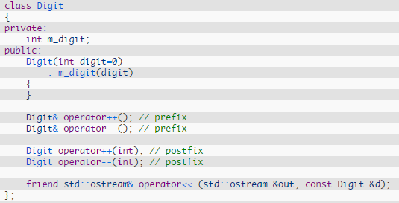
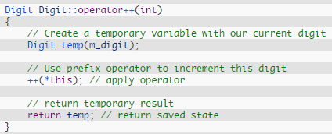
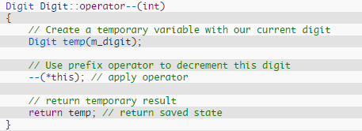
Overloading the increment and decrement operators - postfix

Slide 13
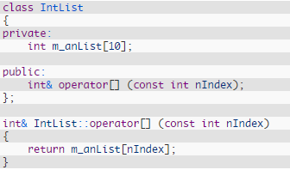
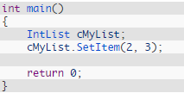

Overloading the subscript operator
class IntList
{
private:
int m_anList[10];
};
How to set/get an item in array?
Solution 1: Create access function
Solution 2: overload the subscript operator ([])
Without seeing the definition of SetItem(), it’s simply not clear

Slide 14
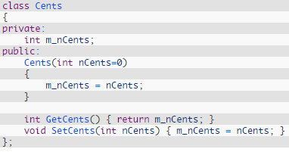

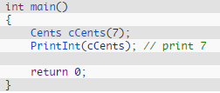
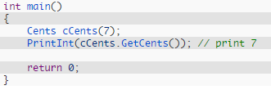

Overloading typecasts (1/2)
How to print the value of m_nCents?
Is it better?
How to implement?
Code becomes messy
Note:
To overload the function that casts our class to an int, we write a new function in our class called operator int(). Note that there is a space between the word operator and the type we are casting to
Casting operators do not have a return type. C++ assumes you will be returning the correct type

Slide 15
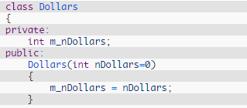

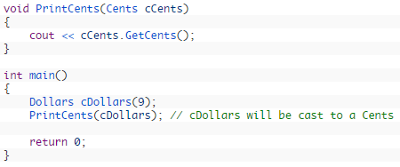
Overloading typecasts (2/2)
1 dollar = 100 cents
How to convert dollar to cent?

Slide 16

Assignment operator and copy constructor
The assignment operator is used to copy the values from one object to another already existing object.
A copy constructor is a special constructor that initializes a new object from an existing object.
If a new object has to be created before the copying can occur, the copy constructor is used
If a new object does not have to be created before the copying can occur, the assignment operator is used
There are three general cases where the copy constructor is called instead of the assignment operator
When instantiating one object and initializing it with values from another object
When passing an object by value
When an object is returned from a function by value
Notes:
Because the second statement uses an equals symbol in it, you might expect that it calls the assignment operator. However, it doesn’t! It actually calls a special type of constructor called a copy constructor.

Slide 17

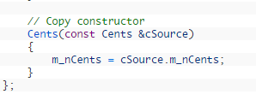
Copy constructor
There are two things which are worth explicitly mentioning
First, because our copy constructor is a member of Cents, and our parameter is a Cents, we can directly access the internal private data of our parameter
Second, the parameter MUST be passed by reference, and not by value
Can you figure out why?
Notes:
The answer lies above in the list that shows the cases where a copy constructor is called. A copy constructor is called when a parameter is passed by value. If we pass our cSource parameter by value, it would need to call the copy constructor to do so. But calling the copy constructor again would mean the parameter is passed by value again, requiring another call to the copy constructor. This would result in an infinite recursion (well, until the stack memory ran out and the program crashed).

Slide 18
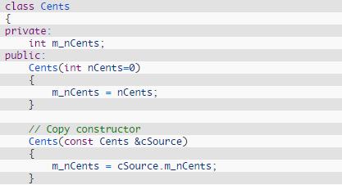

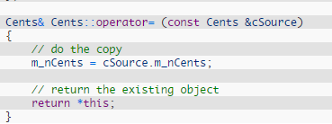
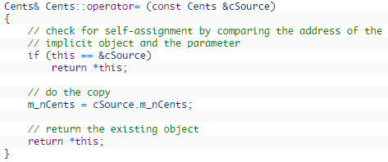
Overload the assignment operator
2 notes:
First, the line that does the copying is exactly identical to the one in the copy constructor
Second, we’re returning *this so we can chain multiple assignments together

Slide 19

Thanks for your attention!

